Slide 1
CAPSTONE PROJECT-3
Mobile Price Range Prediction
TEAM MEMBERS
SATYAM JYOTI SANKAR
KRUSHNAGOPAL BRAHMA

Slide 2
CONTENT
Defining problem statement
EDA and feature engineering
Feature Selection
Preparing dataset for modeling
Applying Model
Model Validation and Selection
Conclusion

Slide 3
Problem Statement
The problem statement is to predict the price range of mobile phones based on the features available (price range indicating how high the price is). Here is the description of target classes:
0 - Low cost Phones
1 - Medium cost phones
2 - High cost phones
3 - Very High cost phones
This will basically help companies to estimate price of mobiles to give tough competition to other mobile manufacturer. Also, it will be useful for consumers to verify that they are paying best price for a mobile.

Slide 4
DATA SUMMARY
Independent variables :
Independent variables :
Battery_power - Total energy a battery can store in one time measured in mAh
Blue - Has bluetooth or not
Clock_speed - speed at which microprocessor executes instructions
Dual_sim - Has dual sim support or not
Fc - Front Camera mega pixels
Four_g - Has 4G or not
Int_memory - Internal Memory in Gigabytes
M_dep - Mobile Depth in cm

Slide 5
DATA SUMMARY(cont..)
Mobile_wt - Weight of mobile phone
N_cores - Number of cores of processor
Pc - Primary Camera mega pixels
Px_height - Pixel Resolution Height
Px_width - Pixel Resolution Width
Ram - Random Access Memory in Mega Bytes
Sc_h - Screen Height of mobile in cm
Sc_w - Screen Width of mobile in cm
Talk_time - longest time that a single battery charge will last when you are

Slide 6
DATA SUMMARY(cont..)
Three_g - Has 3G or not
Touch_screen - Has touch screen or not
Wifi - Has wifi or not
Dependent variables :
Price_range - This is the target variable with value of
0(low cost),
1(medium cost),
2(high cost)
and 3(very high cost).

Slide 7
PREPROCESS DATA
Records=8760 and Features=14
No data is Missing in given dataset.
There are No Duplicate values present
There are No null values.
And ﬁnally we have 'rented bike count' variable which we need to predict for new observations.
We change the name of some features for our convenience , they are as below 'Rented_Bike_Count', 'Hour', 'Temperature', 'Humidity', 'Wind_speed', 'Visibility', ‘Dew_point_temperature', 'Solar_Radiation', 'Rainfall', 'Snowfall', 'Seasons', 'Holiday', 'Functioning_Day', 'month','weekdays_weekend'

Slide 8
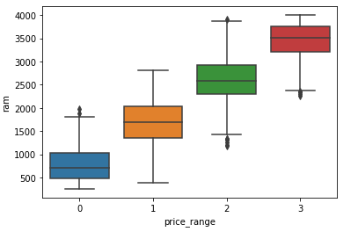
EDA(contd...)
Relation Between Price Range & Ram
This is a positive relationship, with increase in RAM, price too increases. There are 4 types of price range
Type 1(low cost): RAM ranges between 216 to 1974 megabytes.
Type 2(medium cost): RAM ranges between 387 to 2811 megabytes
Type 3(high cost): RAM ranges between 1185 to 3916 megabytes
Type 4(very high cost): RAM ranges between 2255 to 4000 megabytes

Slide 9
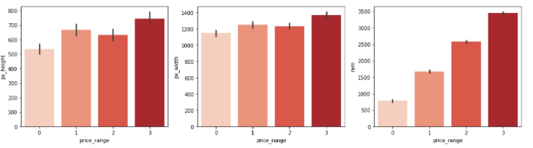
Relationship between the Price Range and Pixel Height/ Width /Ram
Here we see that Ram of phone and price are highly corelated increase in ram increase in price
From the above bar plot, we can see that the average pixel height and width are highest for the price range 3(very high cost).
Low-cost phones have smaller average pixel width and pixel height.
We can observe from this Bar plot that pixel height and pixel width are roughly equal in relevance when it comes to model development for prediction.

Slide 10
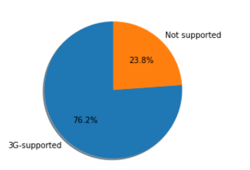
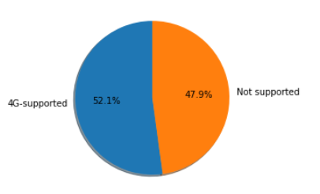
EDA(contd...)
3G-4G supported and Non-supported.
From the above fig, we can see that 3G-supported is 76.2%
and 4G-supported is 52.1%.

Slide 11
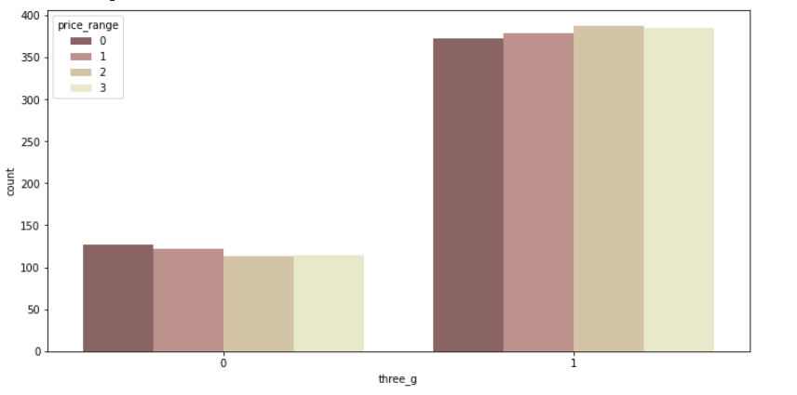
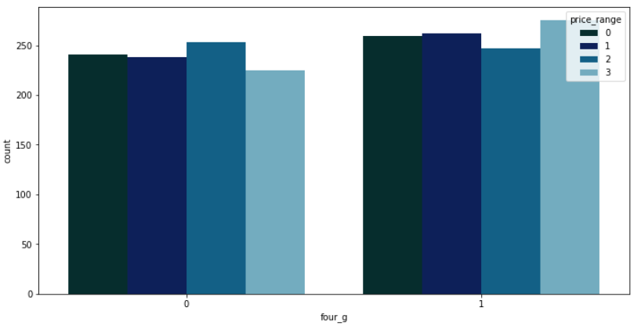
EDA(contd...)
Relation between Price Range & 3G/4G.
Here , we see the price range also affecting the 3G and 4G .

Slide 12
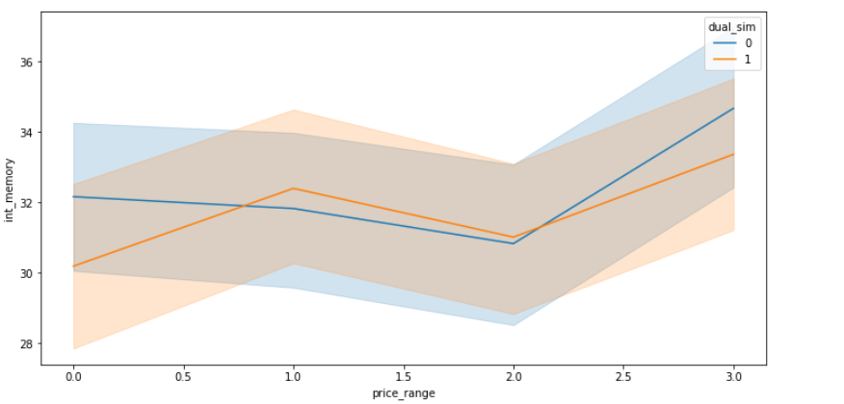
Multivariate analysis - int_memory, mobile_wt
There is drastic increase in internal memory for vey high prices.
Also there is drastic Decrease in mobile weight for very high price

Slide 13
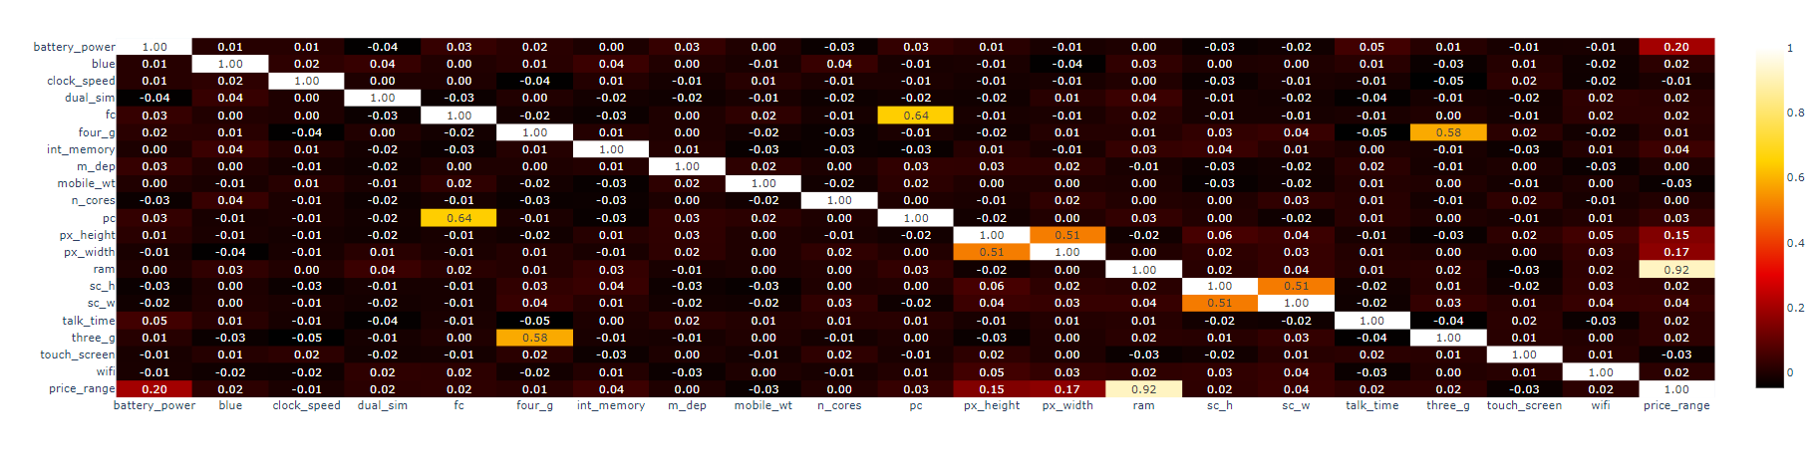
MULTIVATIATE ANALYSIS
From the above correlation graph
three_g and four_g are moderately correlated.
px_width and px_height are moderately correlated. We will try to change them into a single variable.
ram is highly correlated with our price range. May be one the most important factor in determining the price.

Slide 14

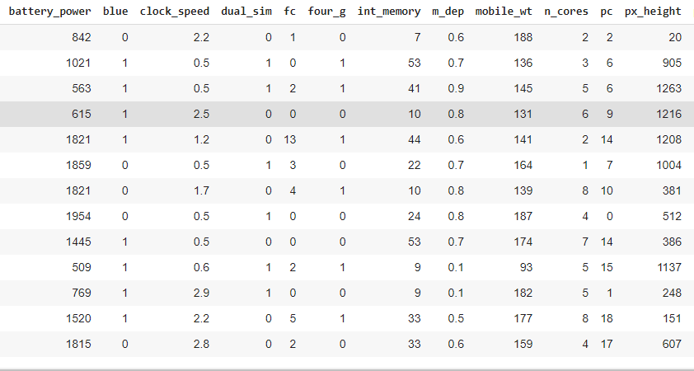
Preparing dataset for modeling
Task : multiclass
classification
Train set : (1340 , 17)
Test set : (660 , 17)
Response : 0-1-2-3

Slide 15
MODEL BUILDING
KNEIGHBOUR CLASSIFIER
RANDOM FOREST CLASSIFIER
GRADIENT BOOSTING CLASSIFIER
LOGISTIC REGRESSION
XGB CLASSIFIERD
DECISION TREE CLASSIFIER
SUPPORT VECTOR MACHINE

Slide 16
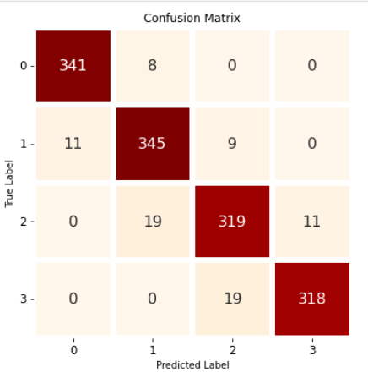
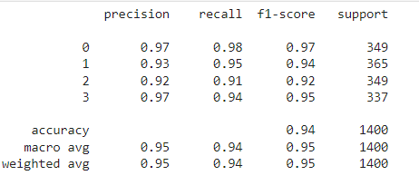
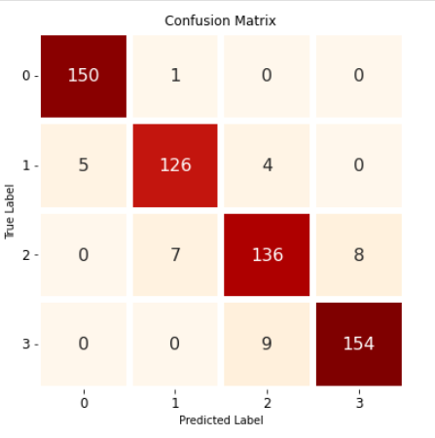
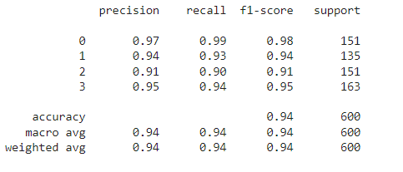
Implementing KNeighbours Classifier contd.
Train metrics
Test metrics

Slide 17
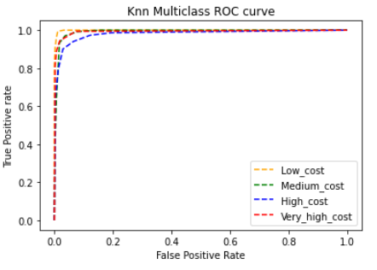
Implementing KNeighbours Classifier
TPR = TP/(TP+FN)
FPR = FP/(FP+TN)

Slide 18
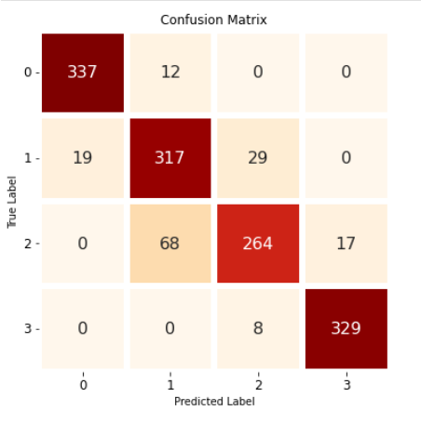
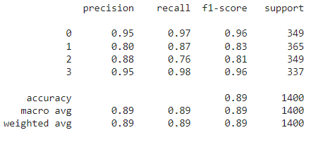
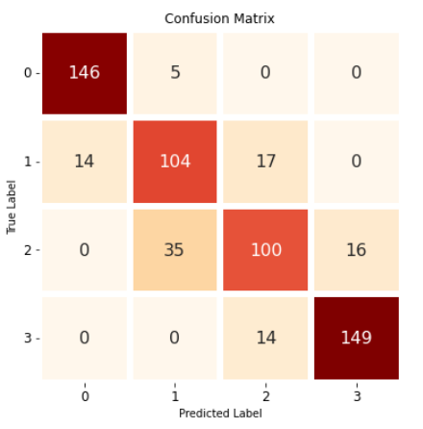
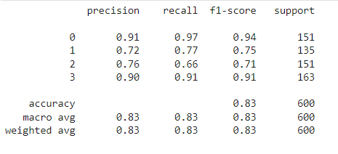
Implementing Random Forest Classifier
Train metrics
Test metrics

Slide 19
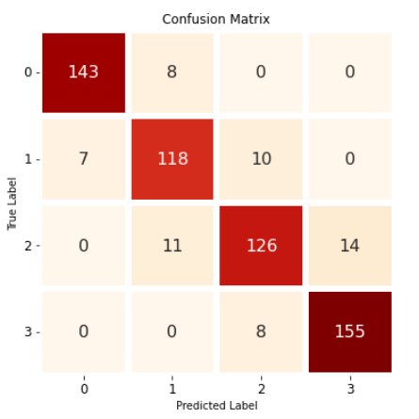
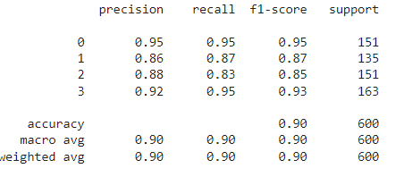
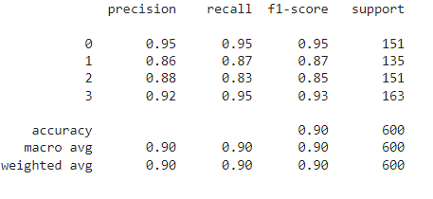
Implementing GradientBoostingClassifier
Train metrics
Test metrics

Slide 20
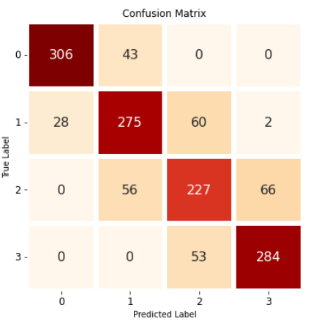
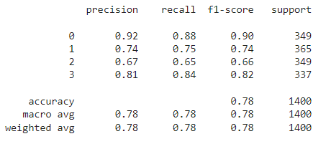
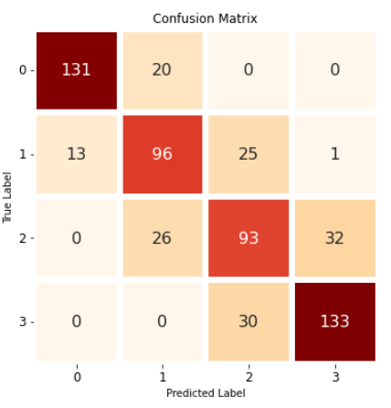
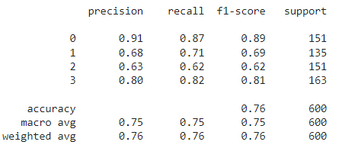
Implementing Logistic regression
Train metrics
Test metrics

Slide 21
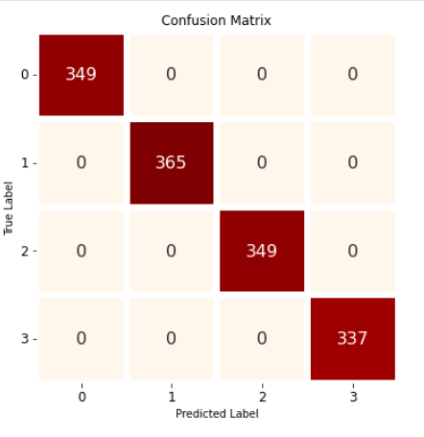
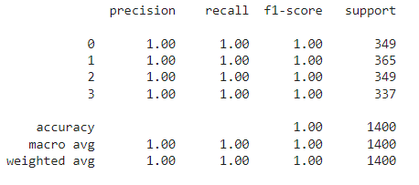
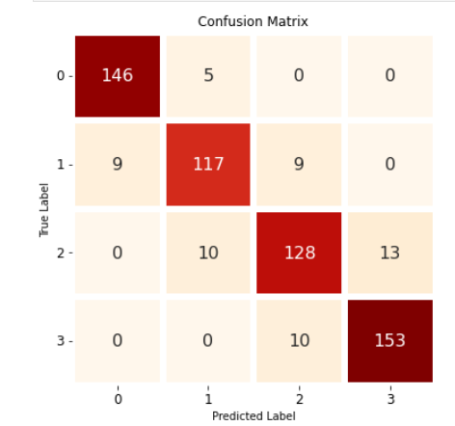
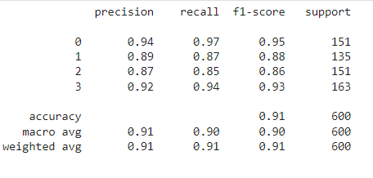
Implementing XGBClassifier
Train metrics
Test metrics

Slide 22
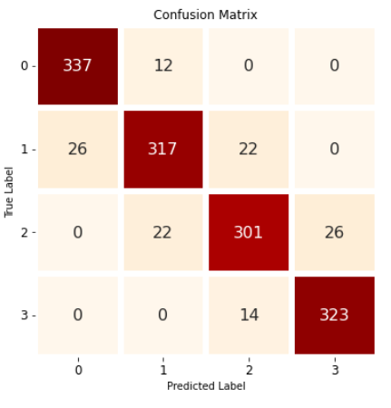
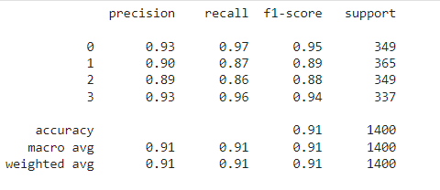
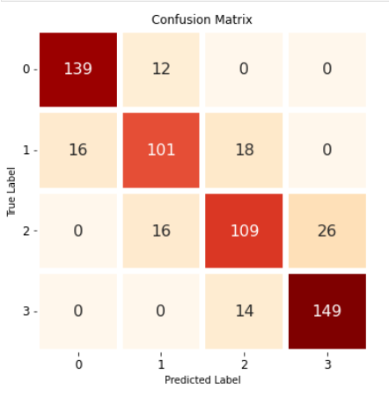
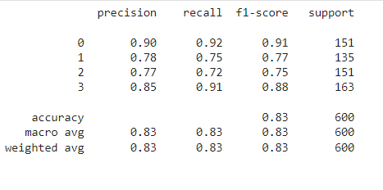
Implementing Decision Tree Classifier
Train metrics
Test metrics

Slide 23
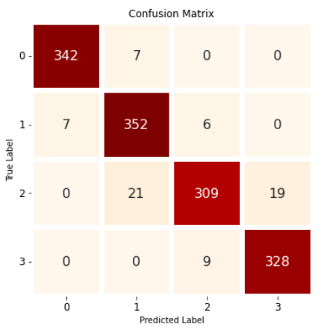
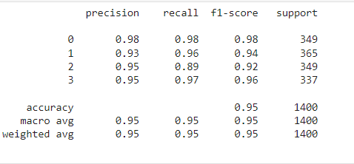

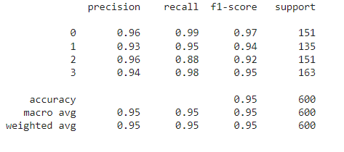
Implementing Support Vector Machine
Train metrics
Test metrics

Slide 24
Best Hyperparameters
So we had chosen Kneighbors classifier for the prediction and the best
hyperparameters obtained are as below
Best hyperparameters :
Train : (algorithm='auto', leaf_size=30, metric=‘Euclidean', metric_params=None, n_jobs=None, n_neighbors=11, p=2, weights='distance’)
Test : (algorithm='auto', leaf_size=30, metric='euclidean', metric_params=None, n_jobs=None, n_neighbors=17, p=2, weights='distance')

Slide 25
CONCLUSION
Ram , Battery_power features were found to be the most relevant features for predicting price range of mobiles and dropping negative correlation features which are clock speed , mobile_wt , touch_screen
Knn gives acc score of 95% and Xg boost 91%.
Xgboost and KNN both are given best roc_auc_accuracy score of 99%.
In case of Xgboost hyper parameter(using grid_search cv ) gives very good result.
Logistic regression is giving the less results among all the algorithms
So we conclude that kneighbors classifier and Xgboost is giving the best results for these dataset
So we can say that in the price range prediction as the ram and battery_power increases the price range will increase for sure .

Slide 26
THANK YOU

